Slide 1
Cambridge International AS & A Level Computer Science 9618 syllabus
Prepared by: Koh Kian Hua

Slide 2
Unit 1.1 - Information Representation

Slide 3
Objectives
After completing this unit, students should be able to:
Understand binary magnitudes and the difference between binary
prefixes and decimal prefixes.
Understand the basis of different number systems.
Perform binary addition and subtraction
Describe practical applications where Binary Coded Decimal (BCD) and
Hexadecimal are used
Use the binary, denary, hexadecimal number bases and Binary Coded
Decimal (BCD)
Use one’s and two’s complement representation for binary numbers
Convert an integer value from one number base / representation to another
Using positive and negative binary integers
Show understanding of how overflow can occur
Familiar with ASCII (American Standard Code for Information Interchange), extended ASCII and Unicode.

Slide 4
Introduction
In a computer, data is represented as a combination of Numbers, Characters and special characters.
The data or information should be in the form machine readable and understandable.
The data has to be converted into electronic pulses and each pulse should be identified with a code.

Slide 5
Introduction
Every character, special character and keystrokes have numerical equivalent (ASCII code).
Thus using this equivalent, the data can be interchanged into numeric format.
For this numeric conversions we use number systems.
Each number system has radix or Base number , Which indicates the number of digit in that number system.

Slide 6
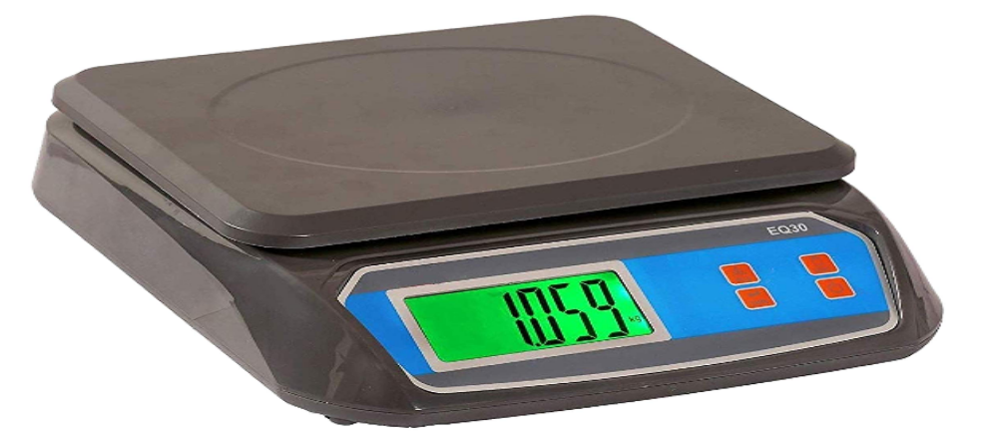
The decimal system
Base (Radix): 10
Decimal digits: 0, 1, 2, 3, 4, 5, 6, 7, 8, 9
Practical Application: Digital Weighing Machine

Slide 7
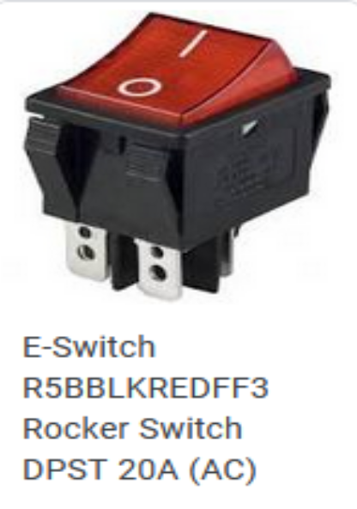
The binary system
Computers use electronic circuits that function as switches that can be turned on or
off. A binary form can be used to represent these two states:
Base (Radix): 2
Decimal digits: 0 (absence of pulse) , 1 (presence of pulse)
Practical Application: Toggle-switch /Light-switch (On (1) / Off (0))

Slide 8
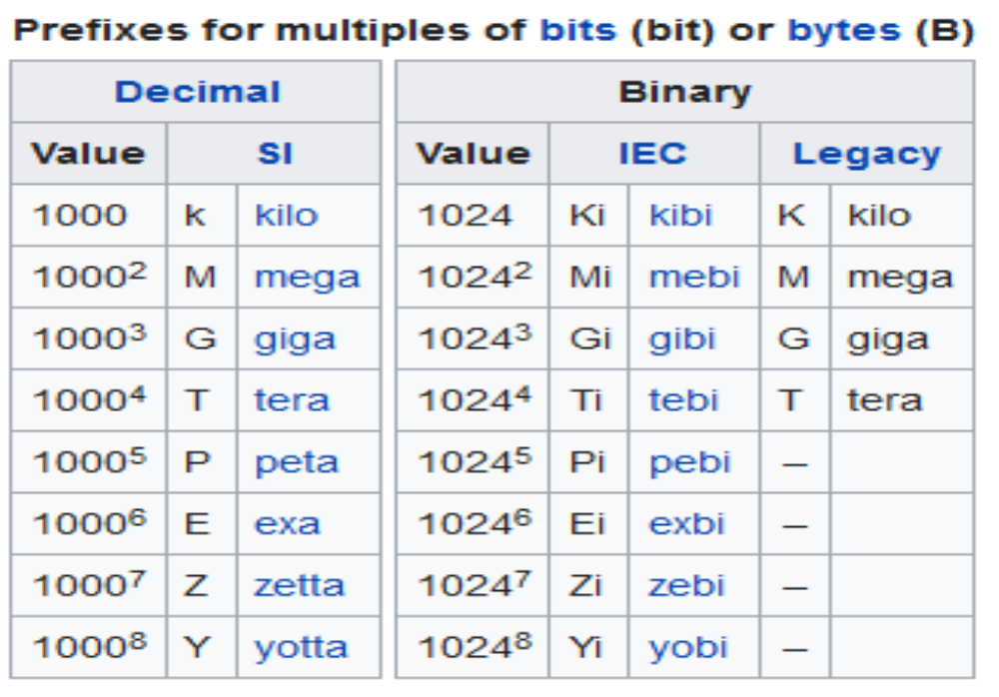
Binary and Decimal Prefix
IEC:International Electrotechnical Commission
SI : International System of Units

Slide 9
The octal system
Base (Radix): 8
Decimal digits: 0, 1, 2, 3, 4, 5, 6, 7
Examples: Octal system is used as a shorthand for representing file permissions (chmod command) on UNIX systems and representation of UTF8 numbers

Slide 10
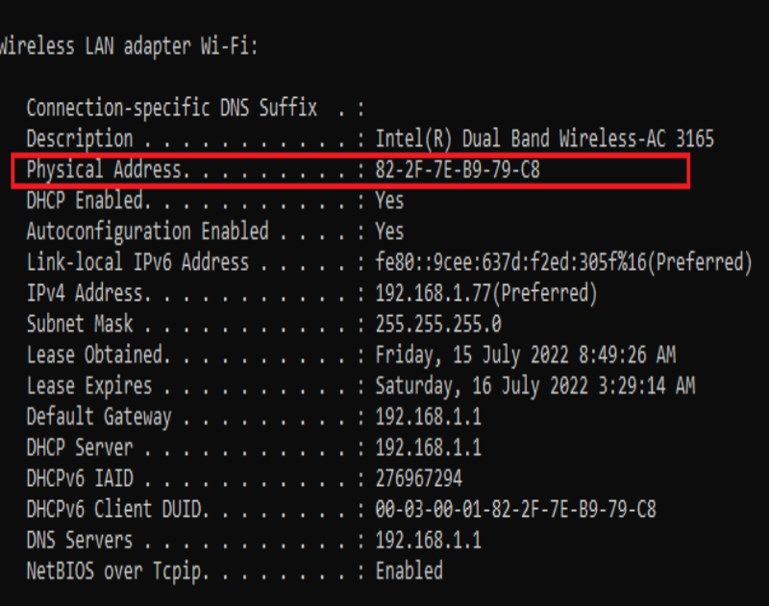
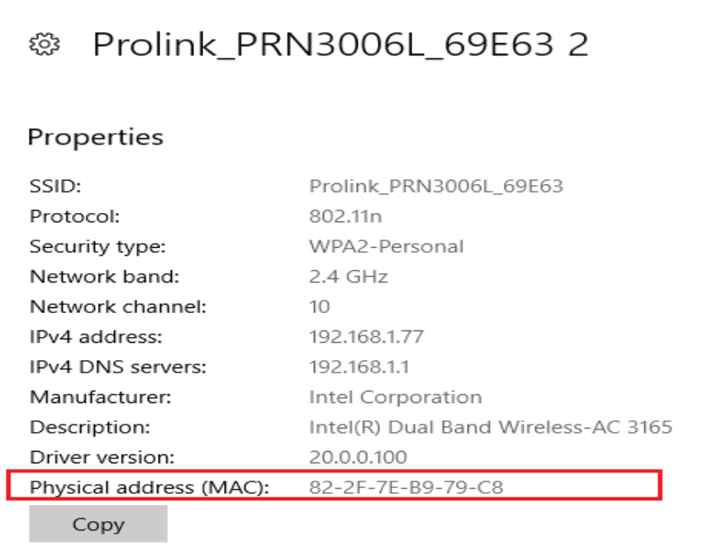
The hexadecimal system
Base (Radix): 16
Hexadecimal digits: 0, 1, 2, 3, 4, 5, 6, 7, 8, 9, A-10, B-11, C-12, D-13, E-14, F-15
Examples: Physical (MAC) Address of Computer or Laptop

Slide 11
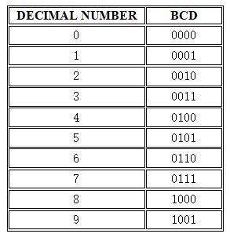
Binary Coded Decimal (BCD)
Binary Coded Decimal, or BCD, is a process for converting decimal numbers into their binary equivalents.
It is a binary encoding method where each digit in a decimal number is represented in the form of bits.
The encoding can be done in either 4-bit or 8-bit (usually 4-bit is preferred).

Slide 12
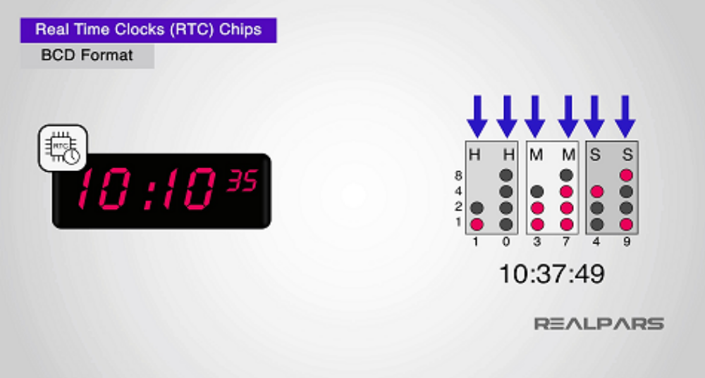
Binary Coded Decimal (BCD)
Practical Applications:
BCD was commonly used for displaying alpha-numeric in the past.
Nowadays, the BCD is used with real-time clocks processor chips to keep track of wall-clock time.
It's common for embedded microprocessors nowadays to include an real-time clock to store the time in BCD format.

Slide 13
Quantities/Counting (1 of 3)
Decimal | Binary | Octal | Hexa- decimal
0 | 0 | 0 | 0
1 | 1 | 1 | 1
2 | 10 | 2 | 2
3 | 11 | 3 | 3
4 | 100 | 4 | 4
5 | 101 | 5 | 5
6 | 110 | 6 | 6
7 | 111 | 7 | 7

Slide 14
Quantities/Counting (2 of 3)
Decimal | Binary | Octal | Hexa- decimal
8 | 1000 | 10 | 8
9 | 1001 | 11 | 9
10 | 1010 | 12 | A
11 | 1011 | 13 | B
12 | 1100 | 14 | C
13 | 1101 | 15 | D
14 | 1110 | 16 | E
15 | 1111 | 17 | F

Slide 15
Quantities/Counting (3 of 3)
Decimal | Binary | Octal | Hexa- decimal
16 | 10000 | 20 | 10
17 | 10001 | 21 | 11
18 | 10010 | 22 | 12
19 | 10011 | 23 | 13
20 | 10100 | 24 | 14
21 | 10101 | 25 | 15
22 | 10110 | 26 | 16
23 | 10111 | 27 | 17

Slide 16
Exercise – true or false...
Number | Decimal | Binary | Octal | Hexa- decimal
100001
33
1110108
1AF
11021
67S

Slide 17
Exercise – true or false...
Number | Decimal | Binary | Octal | Hexa- decimal
100001 | √ | √ | √ | √
33 | √ | × | √ | √
1110108 | √ | × | × | √
1AF | × | × | × | √
11021 | √ | × | √ | √
67S | × | × | × | ×

Slide 18
Summary of the Number Systems
System | Base | Symbols | Used by humans? | Used in computers?
Decimal | 10 | 0, 1, … 9 | Yes | No
Binary | 2 | 0, 1 | No | Yes
Octal | 8 | 0, 1, … 7 | No | No
Hexa- decimal | 16 | 0, 1, … 9, A, B, … F | No | No

Slide 19
Conversion Among Bases
Decimal
Octal
Binary
Hexadecimal

Slide 20
Quick Example
25₁₀ = 11001₂ = 31₈ = 19₁₆
Base (radix)

Slide 21
Decimal to Decimal (just for fun)
Decimal
Octal
Binary
Hexadecimal
Next slide…

Slide 22
Decimal to Decimal
Weight
5 x 10⁰ = 5 +
125₁₀ =>
2 x 10¹ = 20 +
1 x 10² = 100
125
Base

Slide 23
Binary to Decimal
Decimal
Octal
Binary
Hexadecimal

Slide 24
Binary to Decimal
Bit “0”
101011₂
==> (1 x 2⁰)+(1 x 2¹)+(0 x 2²)+(1 x 2³)
+ (0 x 2⁴)+(1 x 2⁵)
= 1 + 2 + 0 + 8 + 0 + 32
= 43₁₀

Slide 25
Octal to Decimal
Decimal
Octal
Binary
Hexadecimal

Slide 26
Octal to Decimal
724₈ =>
4 x 8⁰ = 4 x 1 = 4 +
2 x 8¹ = 2 x 8 = 16 +
7 x 8² = 7 x 64 = 448
468₁₀

Slide 27
Hexadecimal to Decimal
Decimal
Octal
Binary
Hexadecimal

Slide 28
Hexadecimal to Decimal
ABC₁₆ => C x 16⁰ = 12 x 1 = 12 +
B x 16¹ = 11 x 16 = 176 +
A x 16² = 10 x 256 = 2560
2748₁₀

Slide 29
Decimal to Binary
Decimal
Octal
Binary
Hexadecimal

Slide 30
Example
125₁₀ = ?₂
2 125
62 1
2
31 0
2
15 1
2
7 1
2
3 1
2
1 1
2
0 1
125₁₀ = 1111101₂

Slide 31
Decimal to Octal
Decimal
Octal
Binary
Hexadecimal

Slide 32
Example: Decimal to Octal
1234₁₀ = ?₈
8 1234
154 2
8
19 2
8
2 3
8
0 2
1234₁₀ = 2322₈

Slide 33
Decimal to Hexadecimal
Decimal
Octal
Binary
Hexadecimal

Slide 34
Example: Decimal to Hexadecimal
1234₁₀ = ?₁₆
16 1234
77 2
16
4 13 = D
16
0 4
1234₁₀ = 4D2₁₆

Slide 35
Octal to Binary
Decimal
Octal
Binary
Hexadecimal

Slide 36
Example: Octal to Binary
705₈ = ?₂
7 0 5
111 000 101
705₈ = 111000101₂

Slide 37
Hexadecimal to Binary
Decimal
Octal
Binary
Hexadecimal

Slide 38
Hexadecimal to Binary

Slide 39
Example
10AF₁₆ = ?₂
1 0 A F
0001 0000 1010 1111
10AF₁₆ = 0001000010101111₂

Slide 40
Binary to Octal
Decimal
Octal
Binary
Hexadecimal

Slide 41
Example
1011010111₂ = ?₈
1 011 010 111
1 3 2 7
1011010111₂ = 1327₈

Slide 42
Binary to Hexadecimal
Decimal
Octal
Binary
Hexadecimal

Slide 43
Example
1010111011₂ = ?₁₆
10 1011 1011
B B
1010111011₂ = 2BB₁₆

Slide 44
Octal to Hexadecimal
Decimal
Octal
Binary
Hexadecimal

Slide 45
Example
1076₈ = ?₁₆
1 0 7 6
001 000 111 110
2 3 E
1076₈ = 23E₁₆

Slide 46
Hexadecimal to Octal
Decimal
Octal
Binary
Hexadecimal

Slide 47
Example
1F0C₁₆ = ?₈
1 F 0 C
0001 1111 0000 1100
1 7 4 1 4
1F0C₁₆ = 17414₈

Slide 48
Exercise – Convert ...
Decimal | Binary | Octal | Hexa- decimal
33
 | 1110101
 |  | 703
 |  |  | 1AF
Don’t use a calculator!

Slide 49
Summary of Conversion Methods
Conversion Among Bases
Conversion from the binary system to octal, hexadecimal and vice versa.
Conversion from the decimal system to binary, octal or hexadecimal
Conversion from binary, octal or hexadecimal to the decimal system

Slide 50
Arithmetic operations in Binary System

Slide 51
Introduction
The basic arithmetic operations which can be performed rising binary number system are:
Addition
Subtraction
Multiplication
Division

Slide 52
Binary Addition
A | B | A + B
0 | 0 | 0
0 | 1 | 1
1 | 0 | 1
1 | 1 | 10
“two”

Slide 53
Binary Addition
1
1
1
1
1
1
10101 21
+ 11001 + 25
101110 46
1101 13
+ 1111 + 15
11100 28

Slide 54
Binary Subtraction
A | B | A - B
0 | 0 | 0
1 | 0 | 1
1 | 1 | 0
0 | 1 | 1
Borrow one from next higher order digit

Slide 55
Binary Subtraction
111101 61
-100101 - 37
011000 24
101010 42
- 11001 - 25
10001 17

Slide 56
Binary Multiplication
A | B | A  B
0 | 0 | 0
0 | 1 | 0
1 | 0 | 0
1 | 1 | 1

Slide 57
Multiplication
1011
x 11
1011
1011
100001
11
x 3
33
1110
x 1011
1110
1110
0000
1110
10011010

Slide 58
Binary Division
A | B | A / B
0 | 0 | Not acceptable
0 | 1 | 0
1 | 0 | Not acceptable
1 | 1 | 1

Slide 59
Division
010
10 100
10
000
00
00
00101
101 11001
101
00101
101
000

Slide 60
Exercises
1011 + 1101
11001010 – 10011011
1000 * 1001
1001010 / 1000

Slide 61
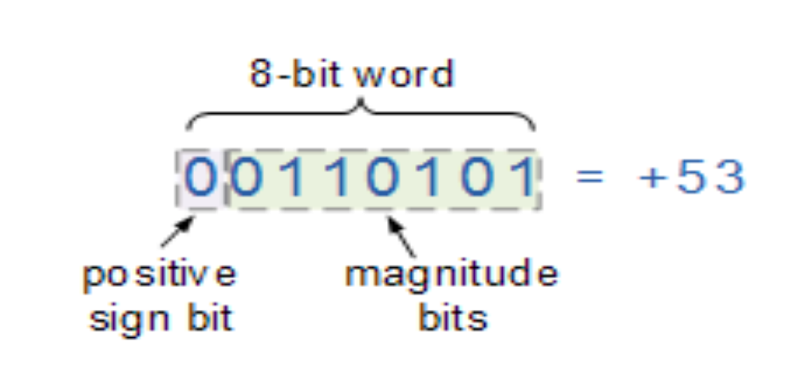
Signed Binary Numbers
Signed Binary Numbers use the MSB (Most Significant Bit) as a sign bit to display a range of either positive numbers or negative numbers.

Slide 62
Signed Binary Numbers
For signed binary numbers the most significant bit (MSB) is used as the sign bit.
If the sign bit is “0”, this means the number is positive in value.
If the sign bit is “1”, then the number is negative in value, the remaining bits in the number are used to represent the magnitude of the binary number in the usual unsigned binary number format way.
The disadvantage is that whereas before we had a full range n-bit unsigned binary number, we now have an n-1 bit signed binary number giving a reduced range of digits.

Slide 63
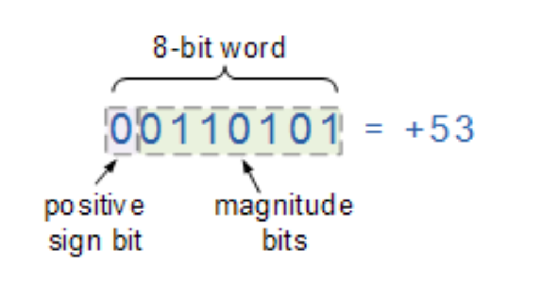
Signed Binary Numbers
Positive Signed Binary Numbers

Slide 64
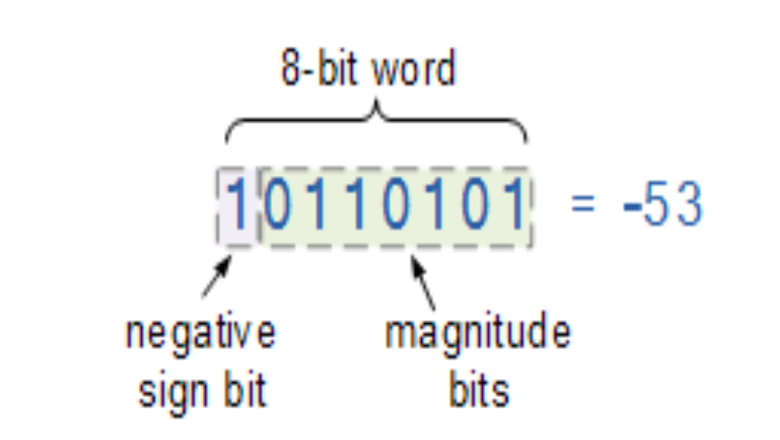
Signed Binary Numbers
Negative Signed Binary Numbers

Slide 65
Signed Binary Numbers
One's Complement of Signed Binary Numbers
The one’s complement of a negative binary number can be obtained by changing each bit in turn.
The one’s complement of “1” is “0” and vice versa, thus the one’s complement of 10010100 is simply 01101011
All the 1’s are changed to 0’s and the 0’s to 1’s.

Slide 66
Signed Binary Numbers
Two's Complement of Signed Binary Numbers
The 2’s Compliment of a binary number is obtained by adding 1 to 1’s Compliment.
Example: (+12)₁₀ = 00001100
1's Complement = 11110011 (converting 0's to 1 and 1's to 0)
2's Complement = 11110011 + 1 = 11110100

Slide 67
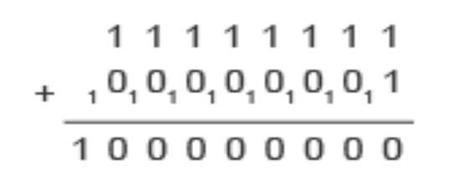
Binary Overflow
A CPU with a capacity of 8 bits has a capacity of up to 11111111 in binary. If one more bit was added there would be an overflow error.
Example: 8-bit overflow
An example of an 8-bit overflow occurs in the binary sum 11111111 + 1 (255 + 1).
In binary, 11111111 + 00000001=100000000 but the leftmost 1 is an overflow number.
The total is a number bigger than 8 digits, and when this happens the CPU drops the overflow digit because the computer cannot store it anywhere, and the computer thinks 255 + 1 = 0.
Overflow errors happen when the largest number that a register can hold is exceeded.
Most CPUs use a much bigger word size than 8 bits. Many PCs have a 64-bit CPU. A 64-bit CPU can handle numbers larger than 18 quintillion.

